Slide 1
Materials for the Research Paper
The Research Paper is Worth:
200 POINTS

Slide 2
Suggested Timeline
Monday March 14 = Determine your topic and create your thesis.
Tuesday March 15 = Brainstorm your writing and outline your paper.
Wednesday March 16 = Research.
Thursday March 17 = Research and outline your paper including your sources.
Friday March 18 = Research and begin writing.

Slide 3
Suggested Timeline
Monday March 21 = Write.
Tuesday March 22 = Finish writing and make sure all sources are cited in the paper with a matching Works Cited Page.
Wednesday March 23 = Re-read your finished draft and make any changes needed (maybe even let someone else read your work and offer suggestions).
Thursday March 24 = Put any finishing touches on your final draft, re-examine the checklist, staple all materials together, and TURN IN PAPER! ☺

Slide 4
Possible Topics
Remember, you can write about any topic that you choose as long as you can ARGUE your point.
Make sure you DO NOT just write an “informative essay.”
If you have questions about a topic just ask Mr. Walblay so he can approve it before you start writing.
A good website to examine possible research topics is listed below:
http://www.myspeechclass.com/good-and-interesting-research-paper-topics.html

Slide 5
Brainstorming Charts

Slide 6
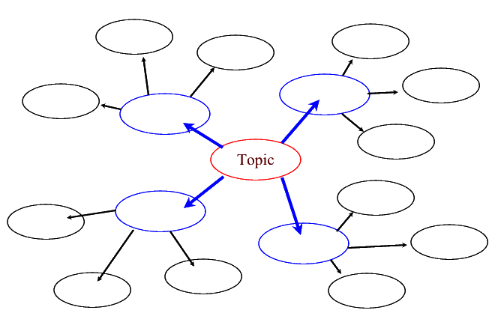
Brainstorming Chart

Slide 7
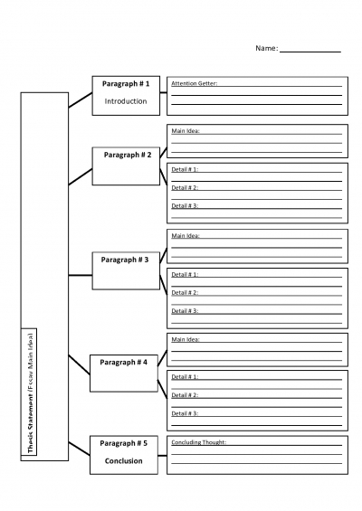
Brainstorming Chart #2

Slide 8
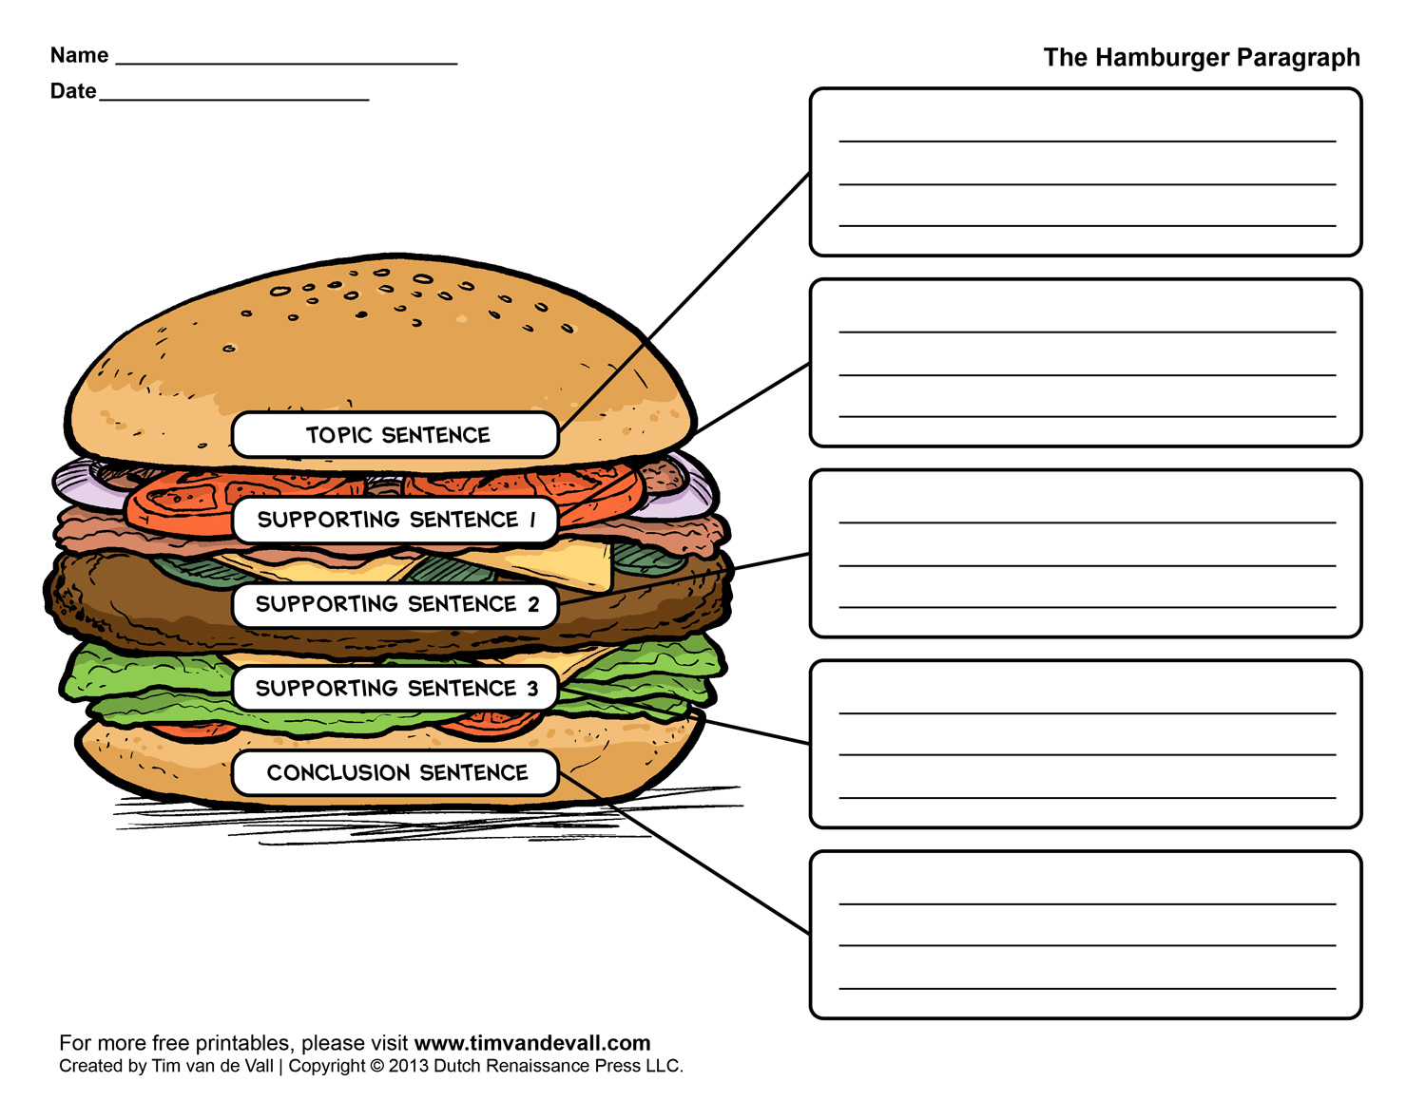

Slide 9
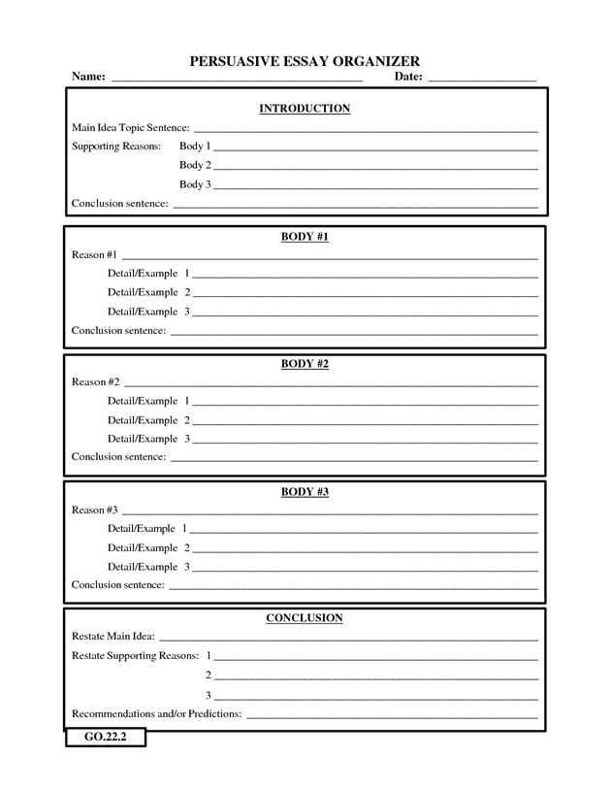

Slide 10
Brainstorming Charts
You can choose (or create) any type of brainstorming/outline sheet that you choose.
Whatever you choose, make sure that it is presented in a professional and organized fashion.
Below is a website that contains numerous brainstorming charts/graphic organizers to help you with your writing:
https://www.eduplace.com/graphicorganizer/

Slide 11
Reminders
Your paper MUST be typed and in MLA Format.
Use 12-Point Times New Roman Font.
Make sure that you have at least 5 sources.
Make sure your paper is turned in ON TIME!
Leave enough time to make revisions on your writing.
Make sure that you stay on topic and that you have five paragraphs.
Look over the rubric and checklist before turning in your paper!

Slide 12
Checklist + Rubric
The checklist and rubric are posted on the class website:
http://mrwgohs.weebly.com

